Slide 1
Office of the Attorney General

Slide 2
US Supreme Court Ruling in North Carolina State Board of Dental Examiners v. FTC: Overview, Implications, and the New Regulatory Landscape

Slide 3
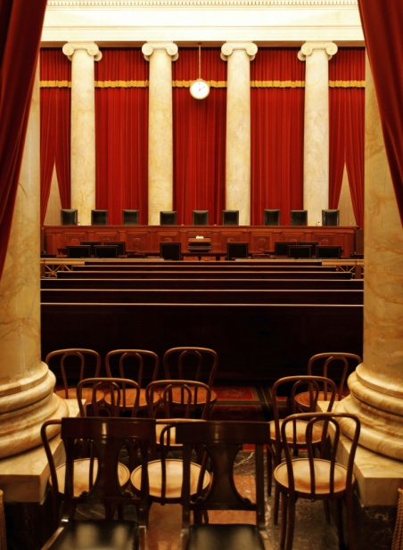
Supreme Court's February 25 Ruling
"If a State wants to rely on active market participants as regulators, it must provide active supervision if state-action immunity ... is to be invoked."

Slide 4
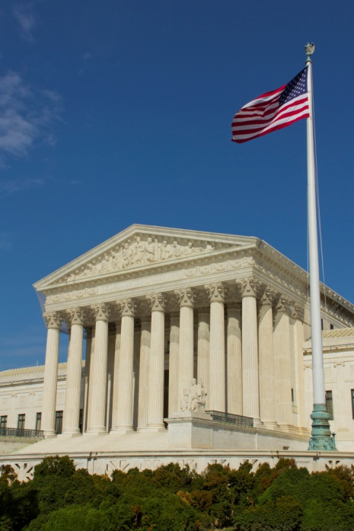
Today's Discussion
Antitrust Overview
Background of the NC State Dental Board case
Summary of Supreme Court's February 25 ruling
Recent FTC Staff Guidelines
Potential implications for regulatory Boards
Pending cases against state regulatory Boards

Slide 5
Antitrust Overview

Slide 6
Principles behind antitrust law
Laws intended to promote competition
Protect free competition from interference by private forces acting in their own self interest
Consumer harm: higher prices, reduced output, lower product or service quality, decreased innovation or product improvement
Premise: free and open competition results in best products and services

Slide 7
Purpose of Antitrust Laws
Goal is to protect competition
Not competitors
Prohibits anticompetitive agreements between competitors
>agreements on price
>agreements to exclude others from the market

Slide 8
State Action Doctrine
Originally established by the Supreme Court as a defense to an antitrust claim in 1943 and elaborated upon in subsequent cases
Actions by a State are not subject to the federal antitrust laws (Immune)
Substrate government entities are also immune, so long as acting pursuant to a “clearly articulated policy to displace competition”
Private entities may be protected if, in addition to acting pursuant to a clearly articulated state policy, they are also “actively supervised” by the state
Florida Regulatory Boards * Substate Entities or Private Entities?

Slide 9
Case Background

Slide 10
Background facts
NC Board of Dentistry which is comprised of 8 members, reviewed its dental practice act; and 6 members are practicing dentists
Concluded act permitted only dentists to whiten teeth
Sent cease-and-desist letters to non-dentists and their suppliers/landlords
Teeth whitening industry complained
FTC opened investigation in 2008
June 2010: FTC concluded NC Board‘s actions were anticompetitive and brought administrative complaint

Slide 11
FTC Administrative Proceeding
FTC lawsuit alleged that NC Board violated antitrust laws
NC Board defense: exempt from federal antitrust laws because it was a state agency and therefore protected by state-action immunity
FTC argued NC Board is a private actor and must therefore meet highest standard to invoke state action immunity (clear articulation and active supervision)
Primary reason: it is “a regulatory body that is controlled by participants in the very industry it purports to regulate” and Board members have a financial incentive to exclude competition

Slide 12
May 2013 Fourth Circuit Ruling
Fourth Circuit affirmed the FTC decision
Emphasis on Board being comprised of a "decisive coalition" of participants in the regulated market chosen by and accountable to fellow market participants
- Thus, private actor and active supervision required to invoke state action immunity - State did not oversee the cease-and-desist letters; generic oversight insufficient
Concurring judge noted that, had Board members been appointed by Governor, it would be a state entity ... And active supervision requirement would not apply

Slide 13
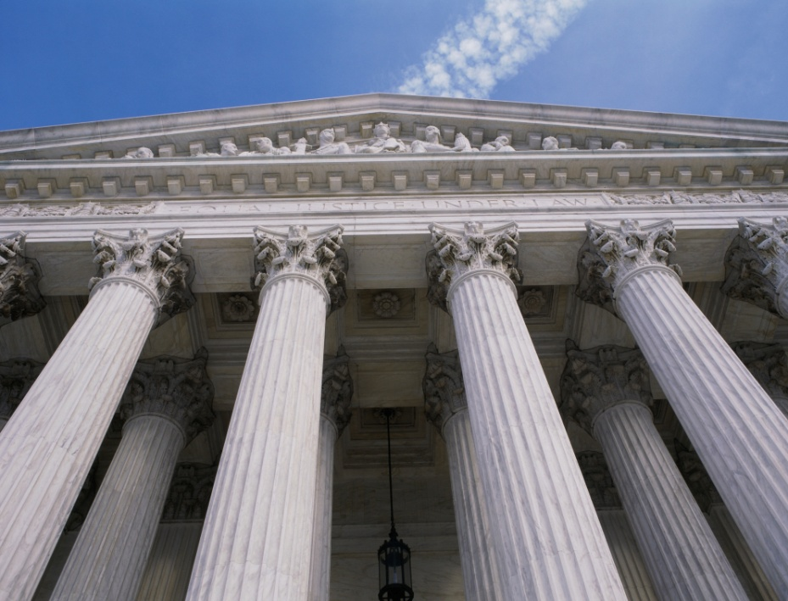
Supreme Court ruling

Slide 14
Overview of Supreme Court Ruling
6 to 3 decision (Alito, Scalia and Thomas dissenting)
Majority's Holding: Because a "controlling number" of the Board's decision makers are "active market participants in the occupation the Board regulates," the Board is treated as a private actor and must show active supervision by the State
The "active supervision" requirement was not met

Slide 15
Majority's analysis
There are limits on immunity: State action immunity exists to prevent conflict between state sovereignty and federal competition policy but it is not unbounded
Board is not sovereign: State agencies are not simply by their governmental character sovereign actors for purposes of state action immunity
The NC Board is a "nonsovereign actor" (an entity whose conduct does not automatically qualify as that of the sovereign state itself)

Slide 16
Majority's analysis (cont’d)
Active Supervision is required: A nonsovereign actor controlled by "active market participants" enjoys immunity only if the challenged conduct is undertaken pursuant to a clearly articulated state policy and is actively supervised by the state
"Clearly articulated policy" prong presumed
State Supervision must be meaningful: lmmunity requires more than a “mere facade of state involvement“ (states must accept political accountability)
Limits on immunity are "most essential when the State seeks to delegate its regulatory power to active market participants"

Slide 17
Majority's analysis (cont’d)
What's in a name: "The need for supervision turns not on the formal designation given by States to regulators but on the risk that active market participants will pursue private interests in restraining trade“
Likened to trade associations: Similarities to private trade associations "are not eliminated simply because Board is given a formal designation by the State, vested with a measure of governmental power, and required to follow some procedural rules"

Slide 18
Majority's analysis (cont’d)
Citizens need not be discouraged from serving
Long tradition of professional self-regulation in US
States may see benefits to staffing agencies with experts
No claim for money damages: Whether Board members may be immune from money damages in some circumstances not addressed
State can provide for defense and indemnification
State can ensure immunity by adopting clear policy to displace competition and (if agency controlled by active market participants) providing active supervision

Slide 19
Majority's analysis (cont’d)
How much state supervision is required?
Test is "flexible and context-dependent”
Don't need day-to-day involvement in operations or micromanagement of every decision
Review mechanism must provide "realistic assurance" that conduct promotes state policy, rather than merely the party‘s individual interests“

Slide 20
Constant Requirements of Active Supervision
The state supervisor who reviews the decision MUST have the power to reverse or modify the decision
The “mere potential” for supervision is NOT an adequate substitute for actual supervision
The State Supervisor Must review the Substance of the decision, not just the Procedures followed to reach it
The State Supervisor MUST NOT be an active market participant

Slide 21
Unanswered Questions
What is a "controlling number"? Majority? Voting bloc? Powerful agency chair?
Who is an "active market participant"?
What is the scope of the market? Must market be relevant to the particular challenged conduct? Would result be different if Board members did not provide teeth whitening?
How much participation makes person "active" in the market?

Slide 22
FTC Staff Guidance
On October 14, 2015 the FTC Staff issued staff guidelines to address two issues raised by the NC Dental Decision:
When does a state Regulatory Board require active supervision in order to invoke the State Action Doctrine?
What factors are relevant to determining whether the Active Supervision Requirement is satisfied?

Slide 23
When is Active Supervision Required?
When a controlling number of Board decision makers are active market participants in the occupation regulated

Slide 24
When is Active Supervision Required?
Active Market Participants Are:
Licensed by that Board
Provides ANY service subject to the regulatory authority of the Board
Includes subspecialties
Temporary suspension of active market participation is not sufficient

Slide 25
When is Active Supervision Required?
Method of Selection – Appointed by Governor versus Elected by the Profession: IS NOT determinative

Slide 26
When is Active Supervision Required?
Controlling Number of Market Participants
Does NOT mean a majority
Fact Bound Inquiry
Voting Blocks
Veto Power
Deference of non-market participants

Slide 27
What Constitutes Active Supervision?
In determining the adequacy of State Board Supervision, the FTC will be guided by the principles of independent judgment and political accountability

Slide 28
What Constitutes Active Supervision?
FTC factors
Independently gathered or reviewed: Board record containing relevant data, public comments, studies and other information
Meaningfully evaluated: Substantive merits of the recommended action examined in light of state legislation and policy
Written Decision: Reasons and rationale for approving, modifying or disapproving recommended action

Slide 29
Examples from the FTC Guidelines
Activities Not Requiring Active Supervision
Prohibitions on regulated person from in engaging in fraudulent business practices
Prohibitions on regulated person from engaging in untruthful or deceptive advertising
Non-Discretionary actions that implement an anticompetitive statutory regime
Denial of license for failure to submit required fee
Denial of license for failure to submit proof of education degree

Slide 30
Examples from the FTC Guidelines
Activities Not Requiring Active Supervision (Cont’d)
Administering disciplinary process for violations of lawful and valid standards
But enforcement affecting multiple persons that substantially affect competition are not IMMUNE and would require active supervision

Slide 31
Examples from the FTC Guidelines
Activities that do not Meet Active Supervision Requirement
Entity Supervising the Board is itself controlled by active market participants
State official monitors Board actions, participates in deliberations but does not have authority to disapprove

Slide 32
Examples from the FTC Guidelines
Activities that do not Meet Active Supervision Requirement (cont’d)
State Attorney General or other State Official advises Board on an ongoing basis
Independent State Agency with veto power only engages in cursory review
Independent State Agency conducts a procedural review but does not substantively review Board actions

Slide 33
Potential Implications

Slide 34
Why Does this Matter to You?
Practitioner members constitute a majority on ALL Boards.
Are Florida Boards subject to “active supervision?”
Four requirements for active supervision
(1) Supervisor must review substance, not merely procedures
(2) must have power to veto and modify
(3) mere potential for supervision not enough; and
(4) supervisor can’t be active market participant.
Lawyers are already bringing private antitrust actions against regulatory Boards in multiple jurisdictions. Its only a matter of time for Florida Boards
Defense attorneys that appear before Florida Boards are already raising the antitrust in defense of their clients
The Supreme Court trend is toward narrowing state action immunity. As demonstrated by the Staff Guidelines the FTC strongly disfavors state action immunity and sets a high bar for “active supervision.”

Slide 35
So now what ?
Your Board Counsel will scrutinize all Board activity for anticompetitive actions or policies
Avoid taking anticompetitive actions
anticompetitiveness necessary consideration when rule-making
avoid issuing opinions (declaratory statements) on scope of practice
Avoid creating grandfathering provisions unless clearly articulated in the enabling statute.
Wait and see what happens this upcoming legislative session.

Slide 36
Potential Strategies in Response to Ruling
Develop greater state supervision over existing Boards (e.g., Governor, legislative Committee, State Court)
Change Board membership so not “controlled” by active market participants
Combine Boards to dilute active market participants (e.g., umbrella Boards, super Boards)
Require legislative ratification of all rules with significant effects on competition
Abandon the Board regulatory model for some or all professions
Make sure that each practice act sets forth a clearly articulated policy to displace competition when appropriate.

Slide 37
Other Considerations
Some activities may be more likely to draw scrutiny than others (e.g., individual disciplinary action vs. broader scope-of-practice question)
Prepare for potential increase in private antitrust claims in response to Board actions
FTC may be encouraged; complaints brought to FTC’s attention may get receptive audience.

Slide 38
Defense and Indemnification of Board Members
Risk Management advises that there is no coverage of defense costs, damages or attorney fee awards in the event a Board Member is sued for Antitrust Violation
However, if suit includes both Antitrust and other covered claims, i.e. 1983, total defense cost would be covered, but only damages for covered claims would be paid by Risk Management
Explore options for obtaining coverage through DMS
Who pays?

Slide 39
Recent Litigation Against State Regulatory Boards
Legal Zoom.com, Inc v. North Carolina State Bar,et al.; USDC MDNC Case No. 1:15-cv-439
Status: Settled
Axcess Medical Clinic, Inc., et ala v. Mississippi State Board of Medical Licensure, et al.; USDC SDMI Case No 3:15-cv-307
Status: Pending
WSPTN d/b/a Beltone Hearing Aid Center, et al. v. Tennessee Department of Health, et al.; USDC MDTN
Status: Pending

Slide 40
Recent Litigation Against State Regulatory Boards
Coestervms.com, Inc v. Virginia Real Estate Appraiser Board; Case No. 1:15-cv-980,USDC EDVA, Alexandria Division
Status: Pending
John M. Robb, DVM v. Connecticut Bd. of Veterinary Medicine, et al.; USDC Conn(Case No.3:15-cv-00903)
Status: Pending

Slide 41
Recent Litigation Against State Regulatory Boards
Ballinger v. Ohio State Bd. of Registration for Professional Engineers and Surveyors; Court of Common Pleas, Warren County Ohio, Case No. 15-cv-86997
Status: Pending
Express Lien, Inc. v. Cleveland Metropolitan Bar Assn, et al.; Civil Action No., 15-cv-02519 USDC EDLA
Status: Pending

Slide 42
QUESTIONS

